Slide 1


Empowering workplaces by championing women's health and reproductive health
Webinar
Monday 15 September, 14:30 – 15:30

Slide 2
Welcome
Rachel Suff
Senior Policy & Practice Adviser - Employee Relations
CIPD

Slide 3
Today’s speakers
Claudia Nicholls
Chief Customer Officer, Simplyhealth
Mariella Frostrup
Menopause Employment Ambassador,
Department for Work and Pensions (UK Government)
Kevin Lyons
Senior HR Manager, Pearson

Slide 4









#StrongerWithCIPD
Wellbeing helpline
Employment Law helpline
Communities and branches
People Management
Knowledge and content
Free learning
Careers support
Professional creditability
Financial support
cipd.org/uk/membership/member-benefits/

Slide 5

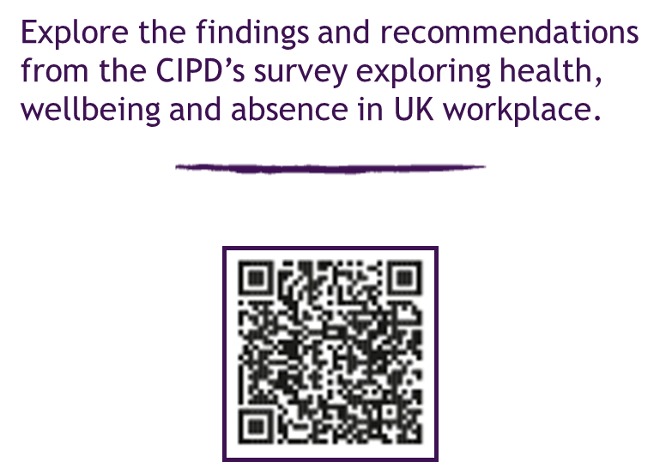
Health and wellbeing at work 2025

Slide 6
Questions
Please share any questions you have for our panellists using the Q&A tab.

Slide 7
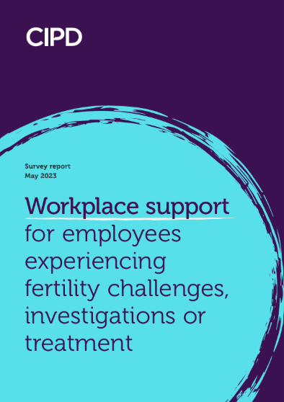
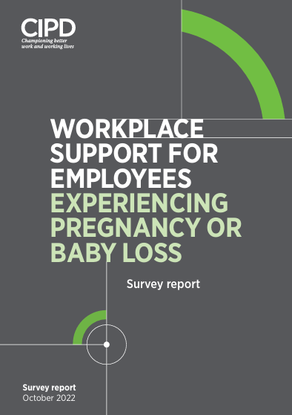


Reports and guides
Explore our resources to learn about the business benefits of championing worker wellbeing and find out how to promote initiatives in your organisation.
cipd.org/uk/topics/wellbeing/

Slide 8
