Slide 1
CIPD Coronavirus webinar series
‘Living with COVID-19’ strategy:
advice for employers
03 March 2022

Slide 2
Welcome
Katie Jacobs, Senior Stakeholder Lead, CIPD

Slide 3
Today’s speakers
Katie Jacobs
Senior
Stakeholder Lead, CIPD
David D’Souza
Membership Director, CIPD
Andrew Willis,
Head of Legal,
Croner
Harvey Francis
Executive Vice President and Chief People Officer, Skanska

Slide 4










#StrongerWithCIPD
Covid-19 resources
NEW Well-being helpline
Employment Law helpline
Communities and branches
People Management
Knowledge and content
Free learning
Careers support
Professional creditability
Financial support
cipd.co.uk/memberbenefits

Slide 5
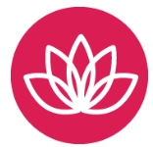
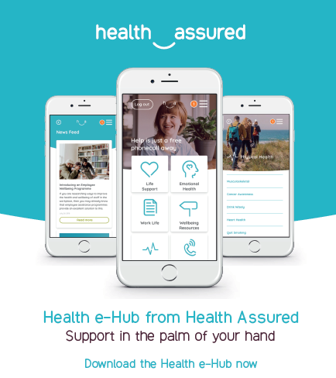
*New* Wellbeing Resources
We’ve partnered with Health Assured to support members mental health and wellbeing
Unlimited free 24/7 confidential telephone helpline, online portal & Health e-Hub app
The resource provides:
Legal information
Debt and financial information
Manager consultancy and support
Information on work and home issues
Factsheets, advice, information and self-help tools
Links to specialist support organisations
A resources area with; programmes, videos, webinars, medical information and mini health checks.

Slide 6

Legal insight
Andrew Willis, Head of Legal,
HR-Inform

Slide 7
What is changing? (1)
From 24 February 2022:
removal of legal requirement to self-isolate following positive Covid test
removal of requirement to self-isolate for close contacts who are not fully vaccinated
end of self-isolation support payments (including the £500 payment for those on low incomes)
end of legal obligation for individuals to tell their employers when they are required to self-isolate
From 24 March 2022:
removal of entitlement to be paid SSP from day-one for Covid-related absences
removal of entitlement to be paid SSP for periods of self-isolation where employee has not tested positive or is not unwell
no further claims under the Coronavirus SSP Rebate Scheme

Slide 8
What is changing? (2)
From 1 April 2022:
removal of free universal symptomatic (PCR) and asymptomatic (lateral flow) testing for the general public
removal of guidance on voluntary Covid-status certification in domestic settings and removal of recommendations that certain venues should use the NHS Covid Pass
removal of the health and safety requirement for employers to explicitly consider Covid in their risk assessments
new “Working Safely” guidance

Slide 9
Across the UK
Scotland:
no plan to scrap the requirement to self-isolate for people who test positive (although this has never been a legal requirement in Scotland)
length of quarantine to be kept under review
consideration of hybrid working arrangements recommended
Wales:
legal requirement to self-isolate remains for now, can be brought to an end after six days (subject to negative LFTs)
Northern Ireland:
self-isolation after a positive test has never been a legal requirement, it has only ever been the subject of “very strong guidance”
now states self-isolation can be brought to an end after six days (subject to negative LFTs)

Slide 10
Challenges for employers (1)
Self-isolation for Covid-positive employees – reasons to continue:
Continuing Govt. guidance:
Covid-positive individuals should not attend work, should stay at home and avoid other people for at least five full days, LFTs on days five and six
Close-contact cases should work from home if possible, avoid contact with anyone at high risk
Duty of care towards employees generally
Duty of care towards those at highest risk of serious illness if they catch Covid
Reduced risk of transmission in the workplace, impact on sickness absence levels
Asking Covid-positive employees to self-isolate – disincentives:
Employer – no fines for letting someone with Covid come into work anymore
Employee – concerns around support and levels of sick pay may leave employees feeling pressured to come into work

Slide 11
Challenges for employers (2)
Risks of allowing Covid-positive employees to continue attending work:
Potential breach of statutory duty to take reasonable steps to protect employees
Risk of fellow employees “downing tools” – employees and workers are protected from being subjected to a detriment or dismissed for leaving / staying away from the workplace if it poses a serious and imminent threat to their health
Risk of claims by fellow employees – indirect discrimination?
Proportionate means of achieving a legitimate aim?
Solutions:
Encourage employee to take Annual Leave / use TOIL
If possible encourage flexible working – working from home when positive etc.
Consider pay arrangements for periods of self-isolation – check contract, otherwise consider paying full pay if employee not “ill” (sick pay as “normal” for those who are ill)
As a last resort insist on self-isolation – reasonable management instruction? Risk of constructive dismissal claim if unpaid?

Slide 12
Questions
Please submit your questions for:
David D’Souza, Membership Director, CIPD
Harvey Francis, Executive Vice President and Chief People Officer, Skanska
Andrew Willis, Head of Legal, Croner
Please use the Q&A function to submit your questions

Slide 13
*New* Wellbeing Resources
We’ve partnered with Health Assured to support members mental health and wellbeing
Unlimited free 24/7 confidential telephone helpline, online portal & Health e-Hub app
The resource provides:
Legal information
Debt and financial information
Manager consultancy and support
Information on work and home issues
Factsheets, advice, information and self-help tools
Links to specialist support organisations
A resources area with; programmes, videos, webinars, medical information and mini health checks.

Slide 14
#StrongerWithCIPD
Covid-19 resources
NEW Well-being helpline
Employment Law helpline
Communities and branches
People Management
Knowledge and content
Free learning
Careers support
Professional creditability
Financial support
cipd.co.uk/memberbenefits

